Slide 1
Church Technology
An Overview
Your name
youremail@emails.com
youremail@emails.com

Slide 2
What’s the goal?
How can I use this technology to bring myself, my family, and my friends closer to Christ?

Slide 3
20,000 foot overview
LDS.org tools
LDS.org content
Church media
Mobile apps
Service opportunities
Mormon.org
Other websites
LDS Account

Slide 4
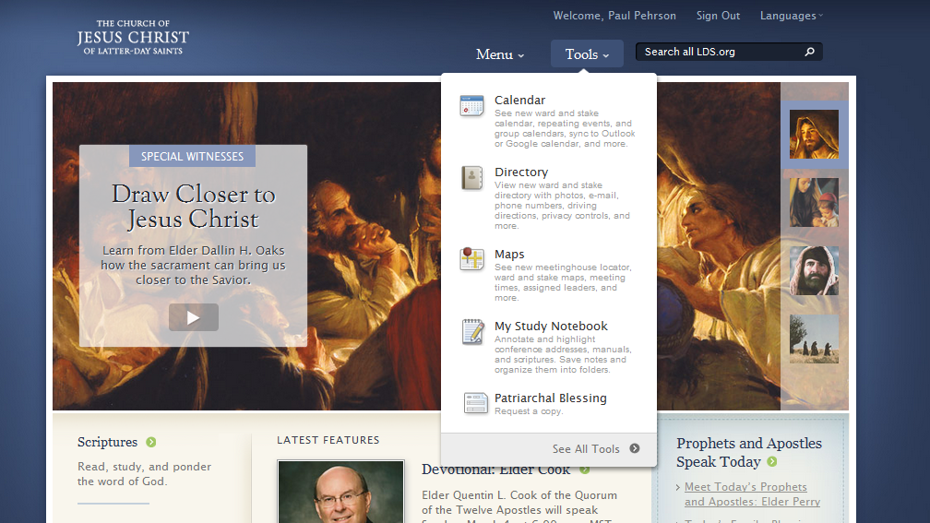
LDS.org tools

Slide 5
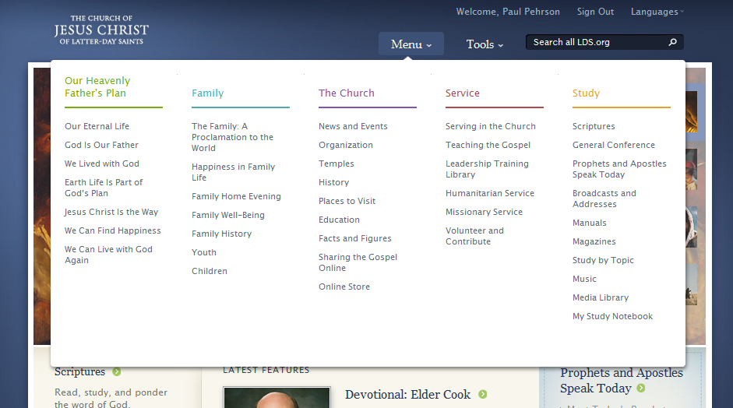
LDS.org content

Slide 6
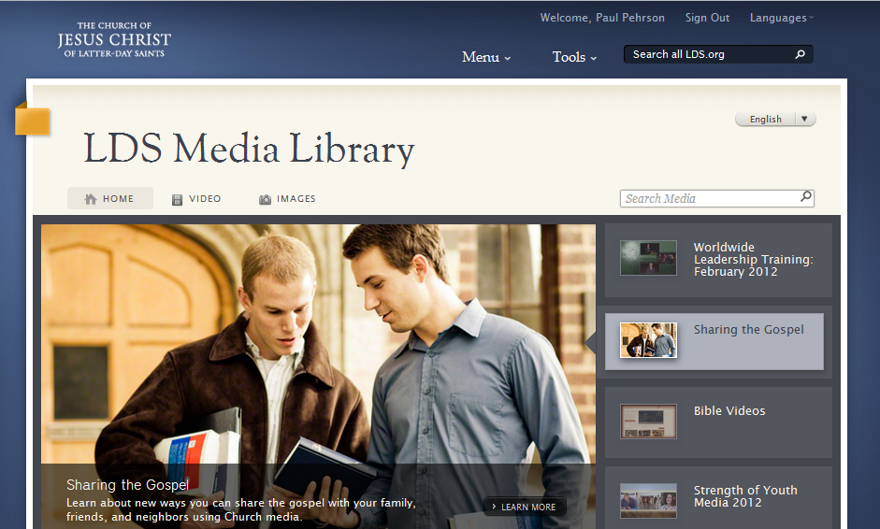
Church media resources
The media library contains both videos and still images that you can use for lessons, family home evenings, Church callings, computer desktop wallpaper, etc.
The background image for this slide presentation came from the LDS Media Library.

Slide 7
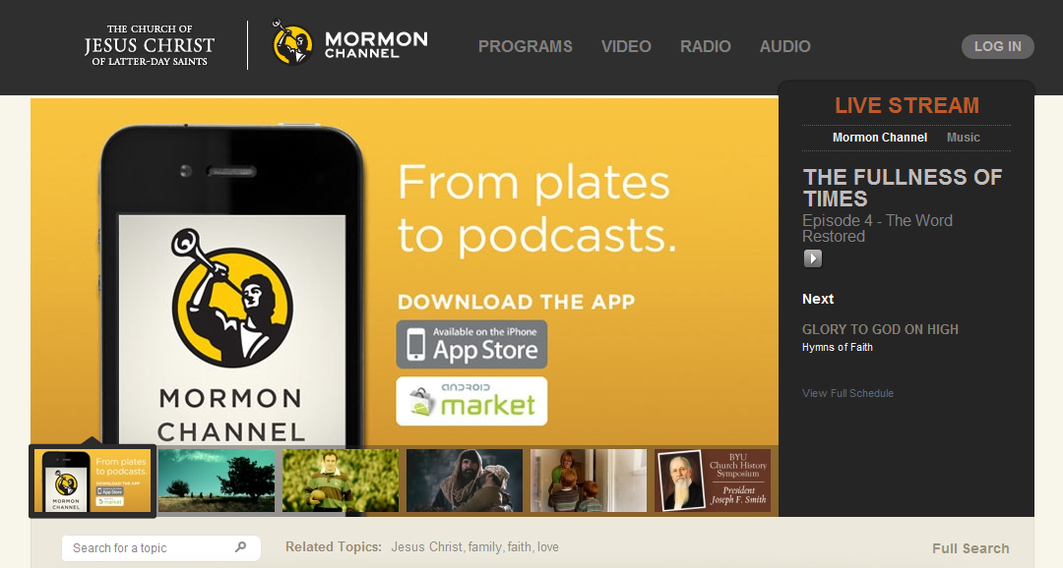
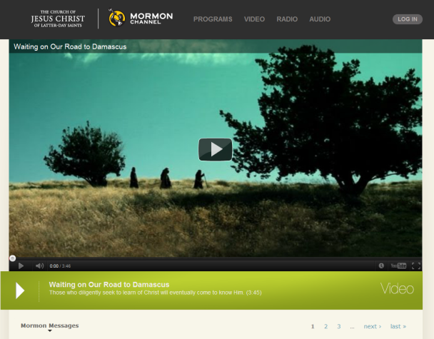
Church media resources
The Church has a radio station called Mormon Channel that you can get via HD Radio, the web, or through a mobile app on your smart phone.
The Church is also consistently putting out new videos on their Mormon Channel website. These are great to share with non-members, and are also perfect for FHE.

Slide 8
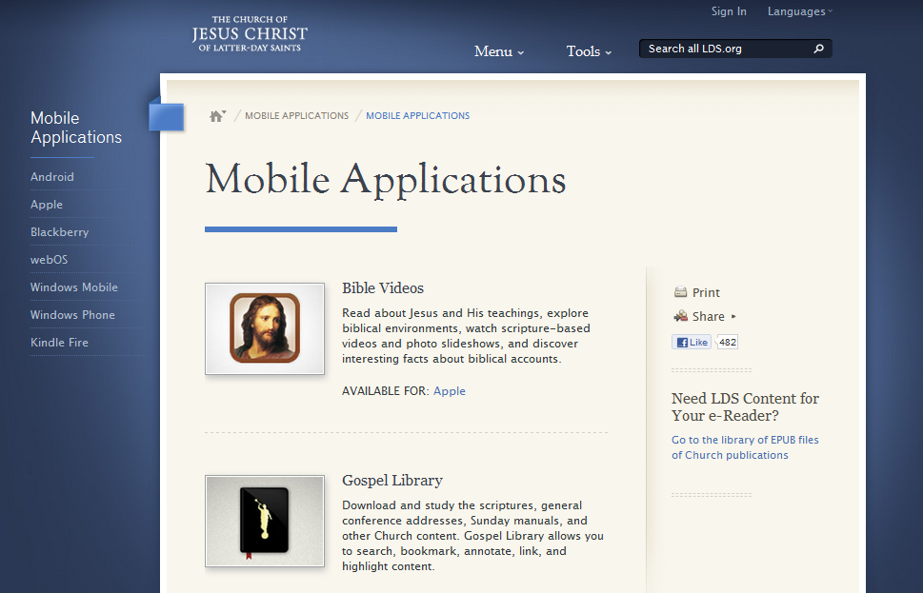
Mobile Apps
Bible Videos
Gospel Library
Mormon Channel
LDS Tools
Scripture Mastery
LDS Youth
LDS Music
Ensign
Family Search indexing

Slide 9
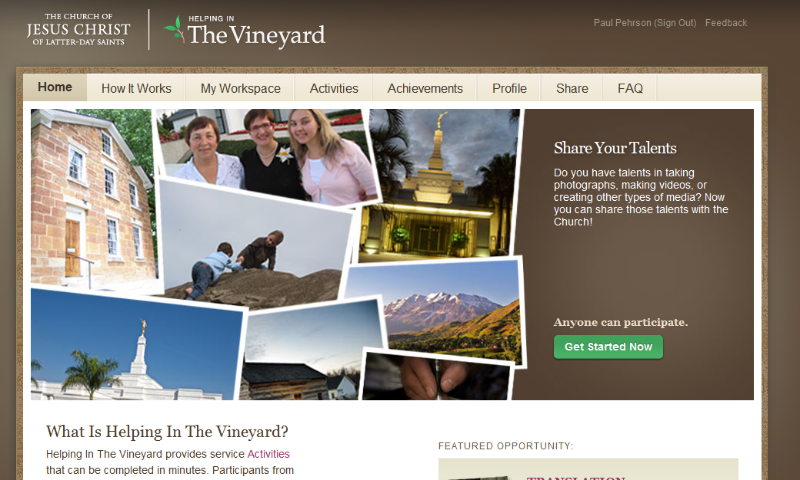
Service opportunities
The Vineyard is a site that allows volunteers to help with projects like indexing, photo tagging, translation, and more.
This “crowdsourcing” method allows many people to do small projects that combine to have a large impact.

Slide 10
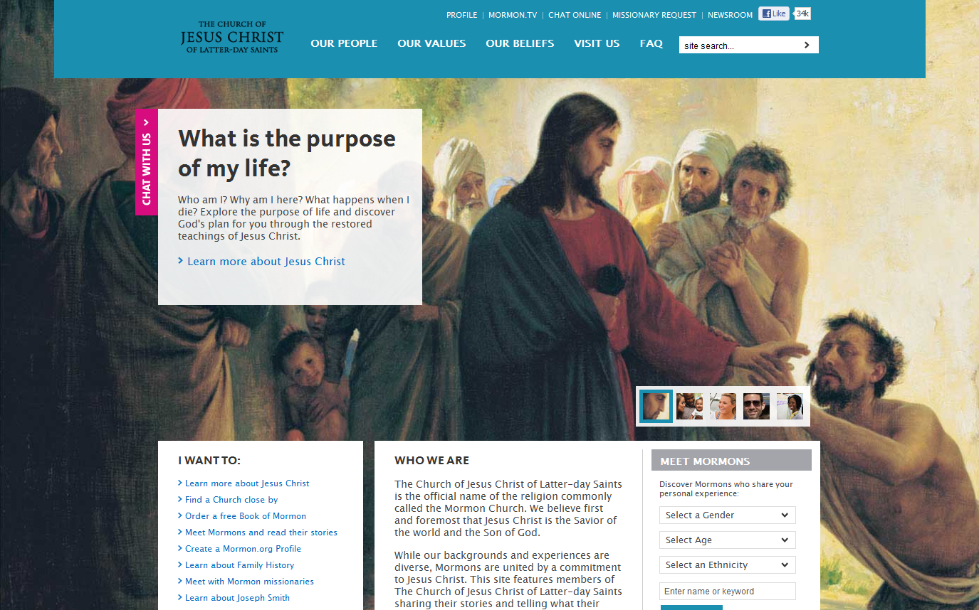
Mormon.org

Slide 11
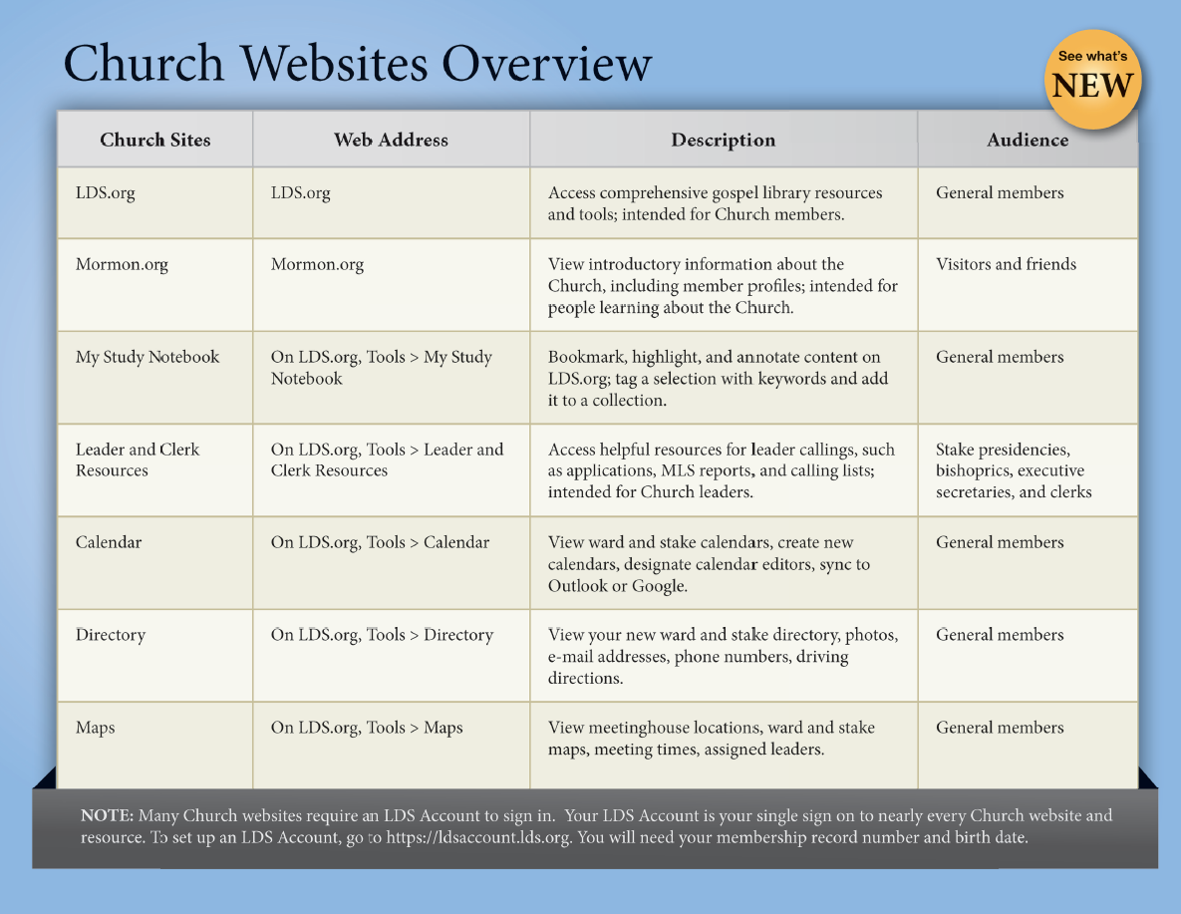
Other websites

Slide 12
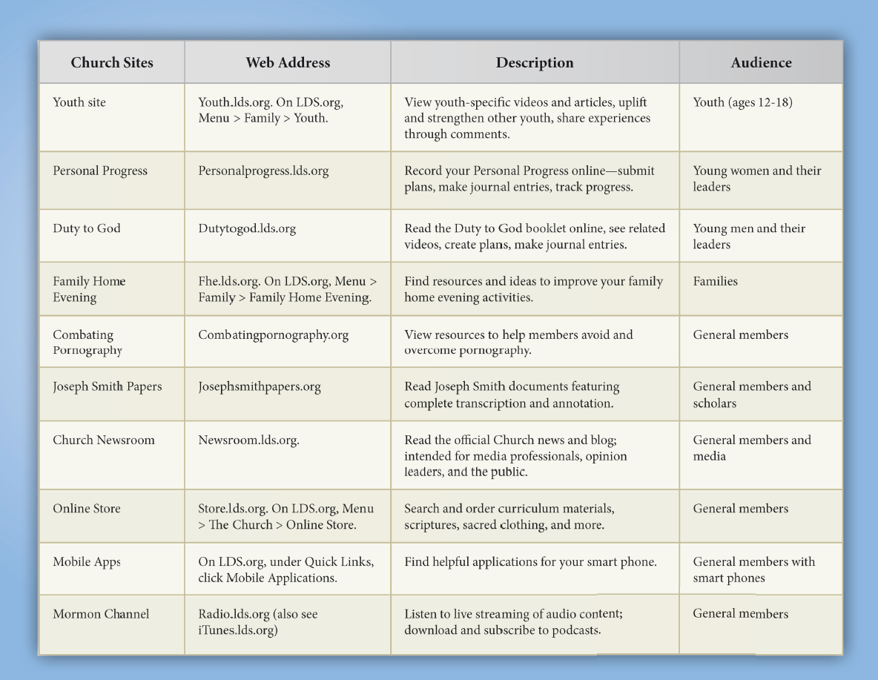
Other websites

Slide 13
Social media from the Church
YouTube
Facebook
Twitter
Google +
Comprehensive
List of social media

Slide 14
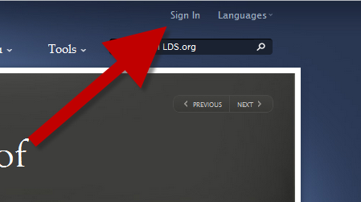
Log in to LDS Account
At the top of any LDS.org website, click Sign in

Slide 15
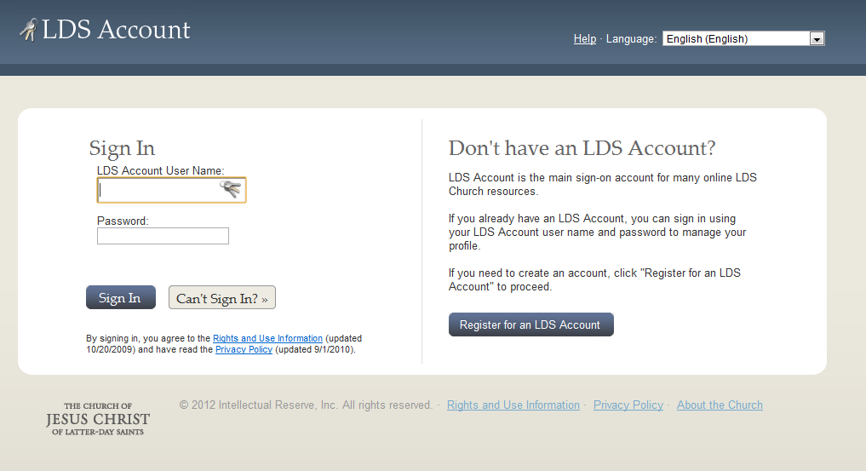
LDS Account
What is it?
Why do I want one?
How do I get one?
What information do I need?

Slide 16
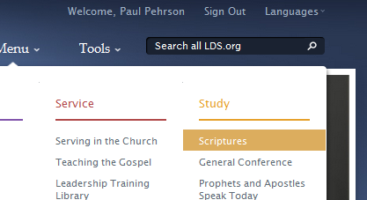
Find your favorite scripture
Look under Menu > Study > Scriptures

Slide 17
It’s cool. But cool isn’t enough.
What features or tools can you use to bring people closer to Christ?
What do you want to know to help you do that?

Slide 18
Review of topics discussed
LDS.org tools
LDS.org content
Church media
Mobile apps
Service opportunities
Mormon.org
Other websites
LDS Account

